Slide 1
Research Paper Maker
Stewart Geisz
Amplify
(openalex, and vertex grounding)
Lets Learn

Slide 2


Multiple subcategories to widen research scope
Company Name
I have it generate a JSON document to give subcategories for the LLM to research individually before combining it back together and synthesizing the outputs into one final research paper.

Slide 3
Output
1. .TXT File
Simplest output type just giving block text from the prompt, useful to be put and automated and read by other machines
2. Markdown
Great for displaying quickly the information to be read well inside the code text editor with CTRL + SHIFT + V
3. DOCX
Most complicated output type requires separate python package to interpret output and put it into a docx format in the APA format

Slide 4
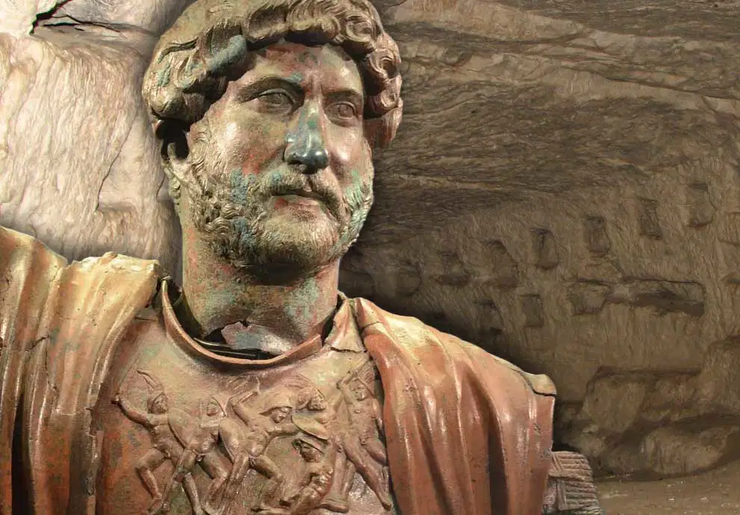


EXAMPLE
Bar Khokba lead a rebellion in the Israel area against the Roman Empire in about 130 AD. Output: Introduction
The Bar Kokhba Revolt (132-136 CE) stands as a pivotal moment in Jewish history, marking the last significant uprising against Roman rule in Judea. Led by Simon Bar Kokhba, this rebellion reflects a multifaceted struggle encompassing military, cultural, and religious dimensions. By synthesizing scholarly findings across various domains, this paper aims to provide a comprehensive understanding of the historical context, military strategies, and cultural implications associated with the Bar Kokhba Revolt.

Slide 5

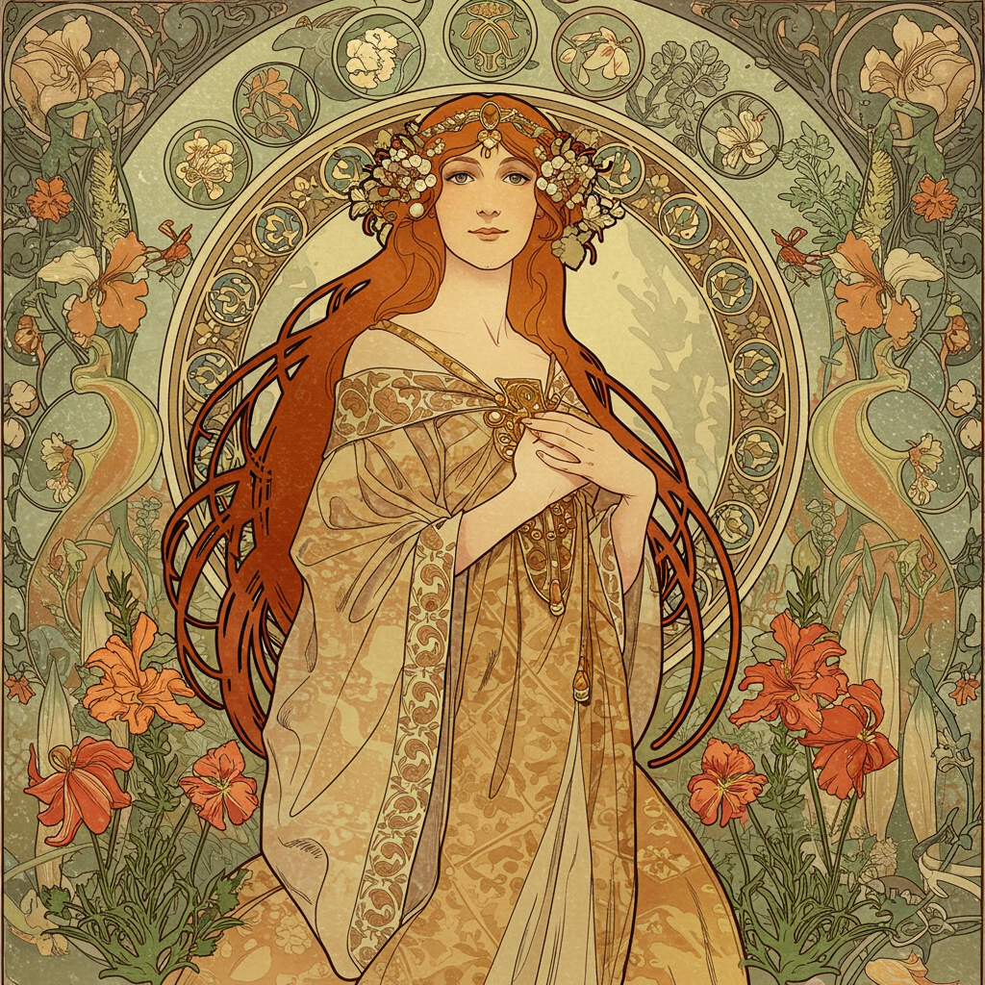


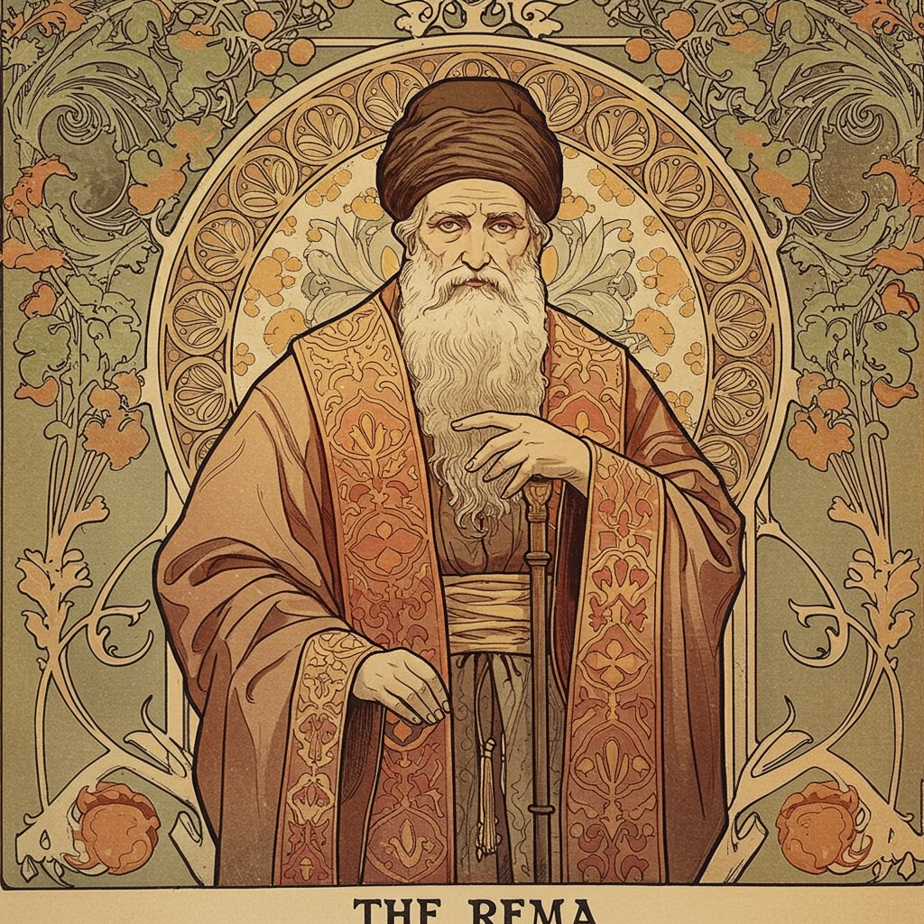

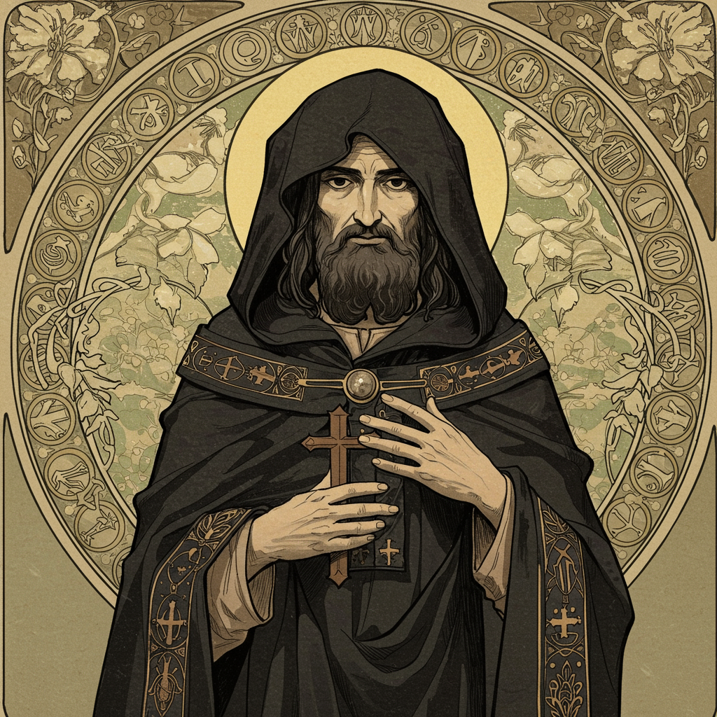

Applications (what I use it for)
I am designing a Czech folklore board game for my Immersion Project and using this information to generate card, factions, and abilities,

Slide 6
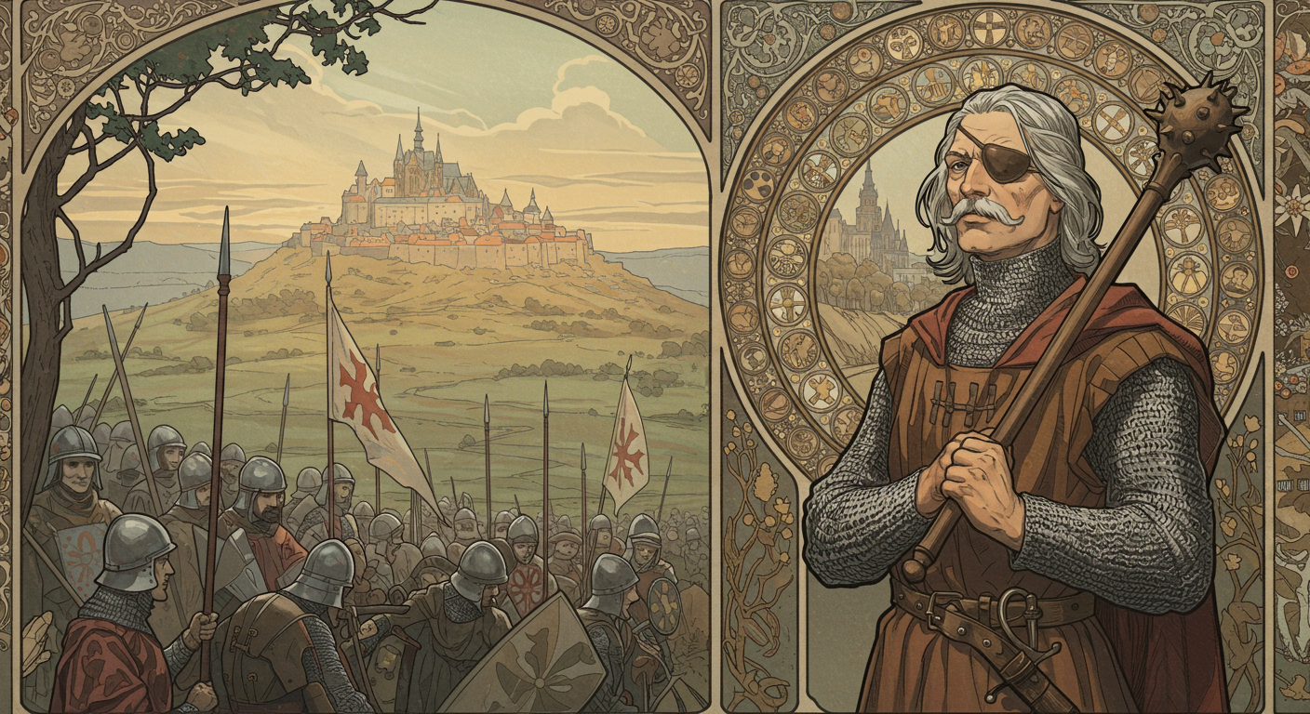
JAN ZIZKA

